Slide 1
Student Performance Dashboard
An interactive tool for visualizing student academic data.
MM/DD/20XX

Slide 2
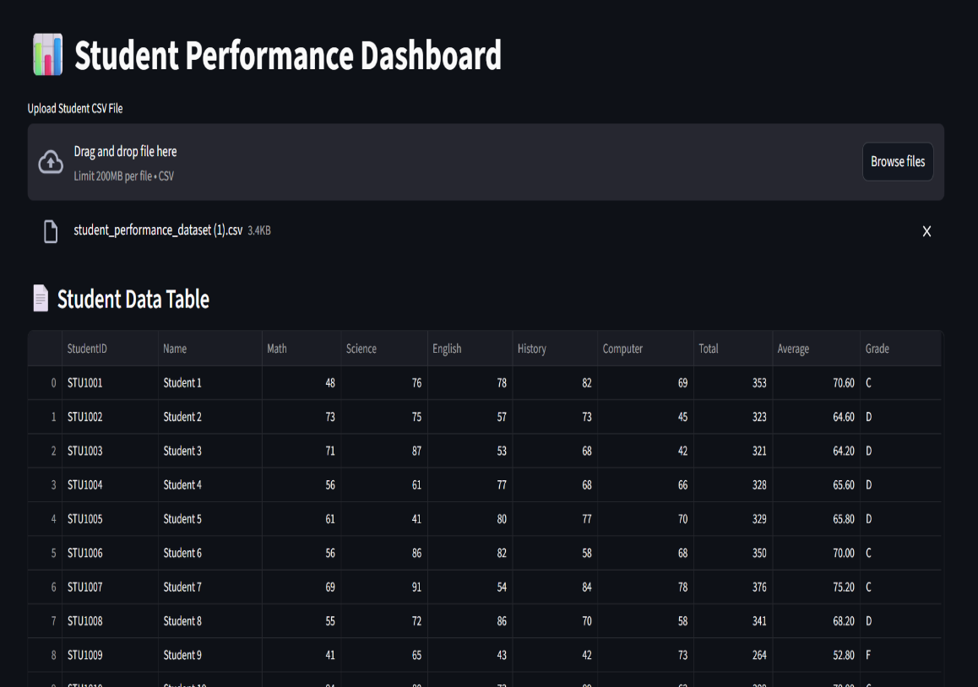
Introduction
The Student Performance Dashboard is an innovative web application designed to visualize academic performance data. This tool empowers educators and institutions to upload student scores in multiple subjects, enabling swift analysis and informed decision-making. With features like detailed insights, interactive charts, and a user-friendly interface, it supports educational data management effectively.

Slide 3
Overview
01

Slide 4
Introduction to the Dashboard
The Student Performance Dashboard offers an interactive platform for analyzing academic data efficiently. Users can easily upload CSV files containing scores across five subjects, enabling a comprehensive view of student performance and facilitating quick insights for educators and administrators.

Slide 5

Importance of Data Visualization
Data visualization plays a crucial role in understanding complex student performance metrics. By leveraging visual elements such as charts and graphs, the dashboard enhances clarity, making it easier for stakeholders to identify trends, strengths, and areas for improvement in student performance across various subjects.

Slide 6
Target Audience and Use Cases
The Student Performance Dashboard is designed for educators, administrators, and academic institutions seeking to enhance their understanding of student performance.
It can be utilized in various contexts, such as school districts for performance analysis, universities for curriculum assessment, or educational NGOs for research purposes.
By presenting data-driven insights, the dashboard supports effective decision-making tailored to diverse educational needs.

Slide 7
Features
02

Slide 8
Interactive Data Upload and Visualization
Users can seamlessly upload CSV files containing student academic scores.
The dashboard instantly generates visualizations, allowing for quick assessments of each student's performance across multiple subjects.
Graphical representations like bar and pie charts facilitate clear comparisons between different metrics and students.

Slide 9
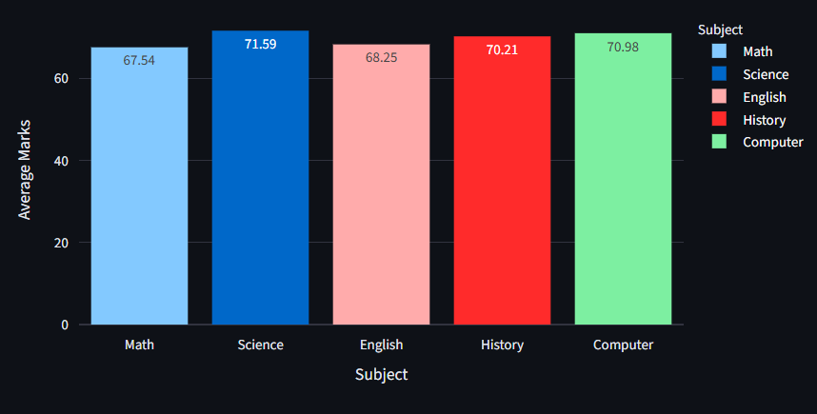
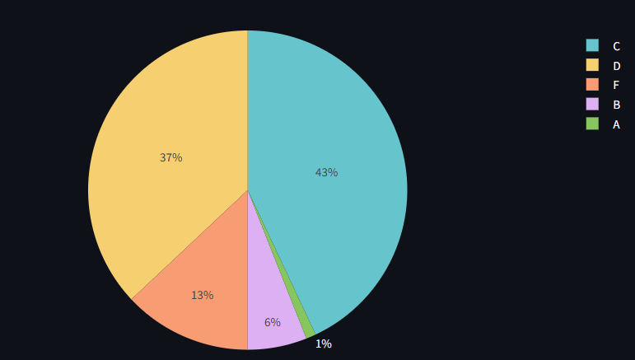
Detailed Insights and Analytics
The dashboard provides essential statistics such as total marks, average scores, and grades for each student.
It features a topper highlight section that showcases the highest achiever, thus motivating students to excel.
Comprehensive analytics empower educators to easily track trends and evaluate the effectiveness of teaching methods.

Slide 10
User-Friendly Interface and Filtering Options
The design prioritizes user experience, with an intuitive interface that is easy to navigate.
Users can filter data by grade, allowing for focused reviews of student performance based on defined criteria.
These features promote efficient data handling and streamline the analysis process for educators and stakeholders.

Slide 11
Conclusions
The Student Performance Dashboard serves as a vital tool for visualizing and understanding academic performance.
Its interactive features and user-centered design support educators in tracking student progress and making informed decisions.
By leveraging data visualization, this dashboard enhances educational strategies and fosters a culture of continuous improvement.

Slide 12
Thank you!
Do you have any questions?
+00 000 000 000

